Slide 1
New Hostels locations in Porto

Slide 2
Background
Porto is a Portuguese northern city;
Second biggest city of Portugal;
For the last 20 years the tourism has increased significatively;
There was huge business creation like restaurants, bars and hostels;
There is high demand for accomodation;

Slide 3
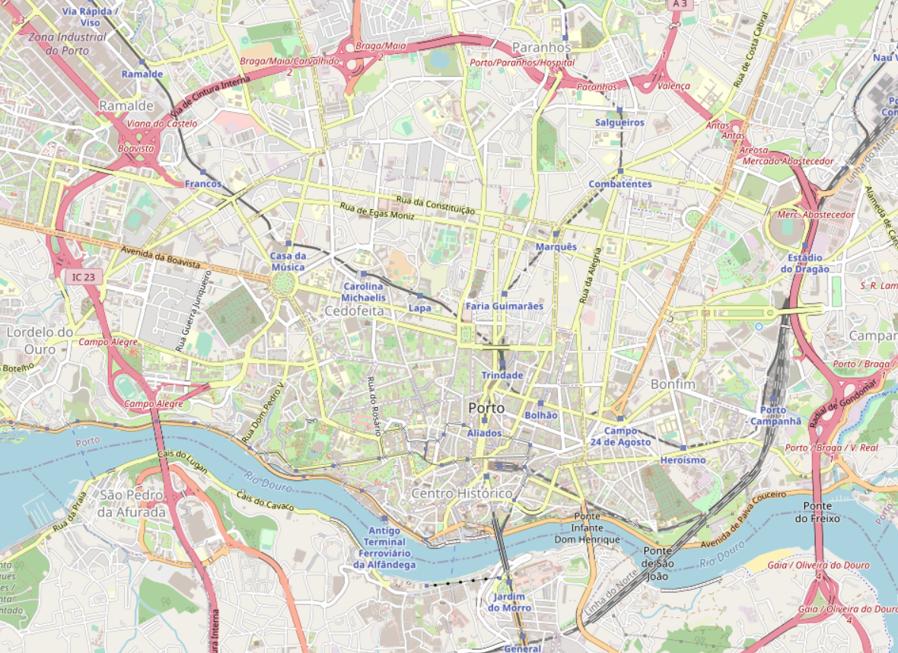
Problem description
Identify most suitable locations to open new hostels in Porto centre, Portugal.
Figure 1 – Porto city centre.

Slide 4
Criteria and data exploration
Identify high density restaurants and bars regions where there is a lack of accomodations nearby;
Opportunity for new hostels installation.
Identify high density hostels regions;
Regions to avoid for new hostels installation.
The data is obtained using Foursquare;
Using K-Means Neighbours identify the respective regions.

Slide 5
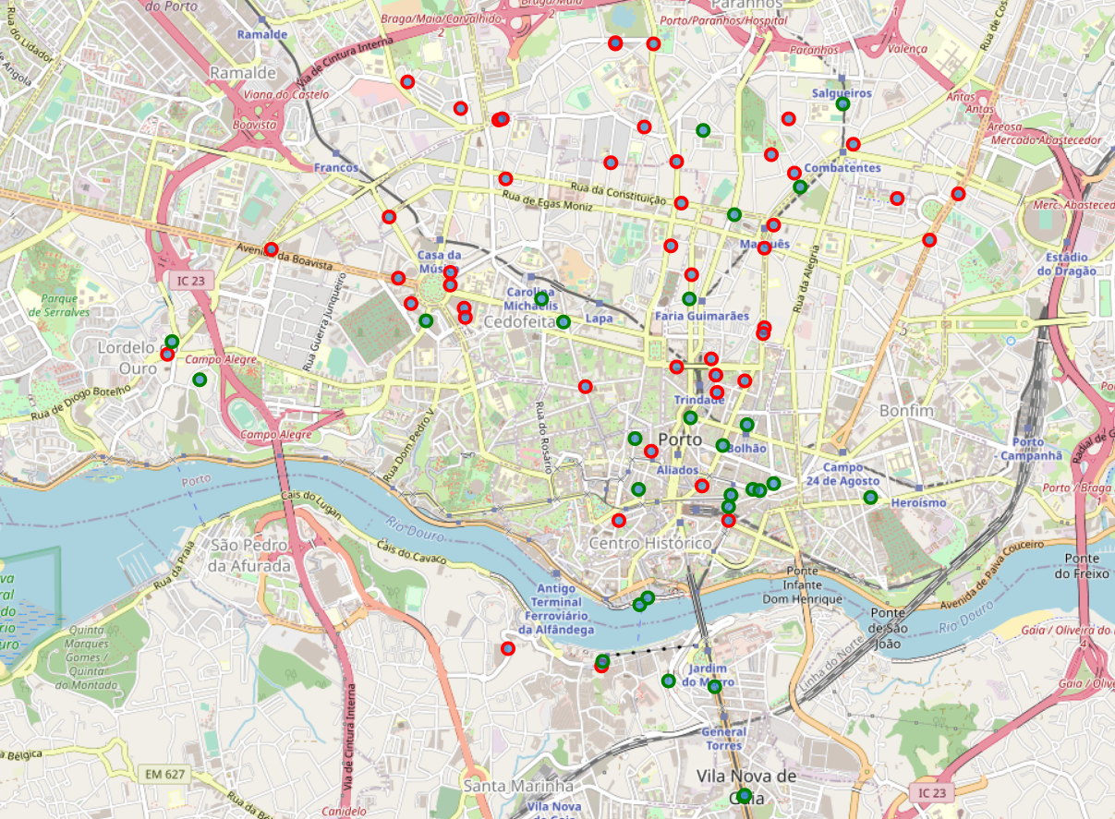
Restaurants and bars locations
Figure 2 – Restaurants (red points) and bars (green points)

Slide 6
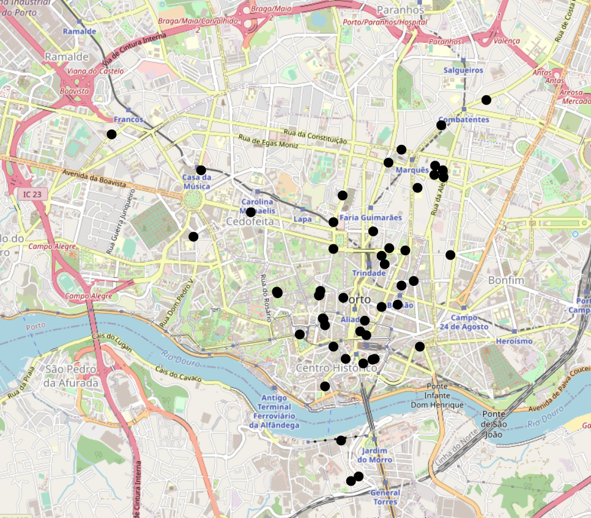
Hostels locations
Figure 3 – Hostels locations

Slide 7
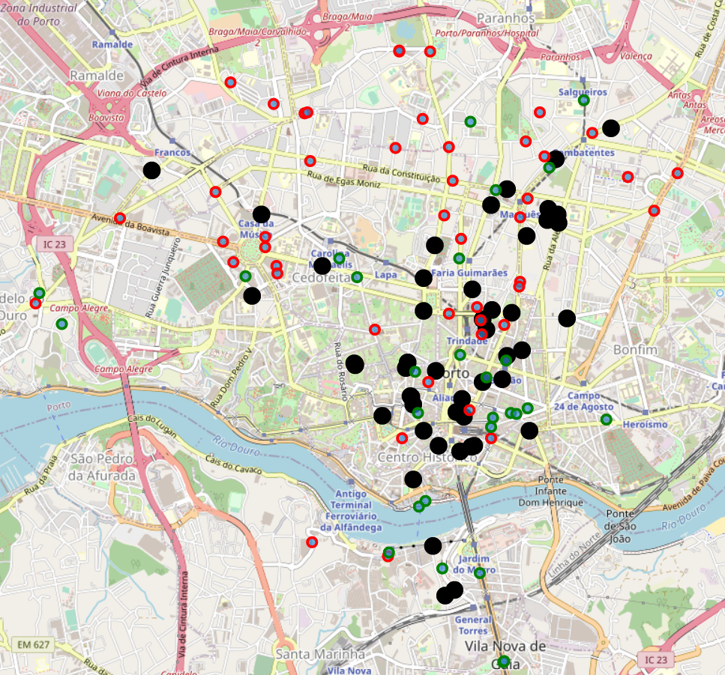
Restaurants, bars and hostels
Figure 4 – Restaurants (red), bars (green) and hostels (black).

Slide 8
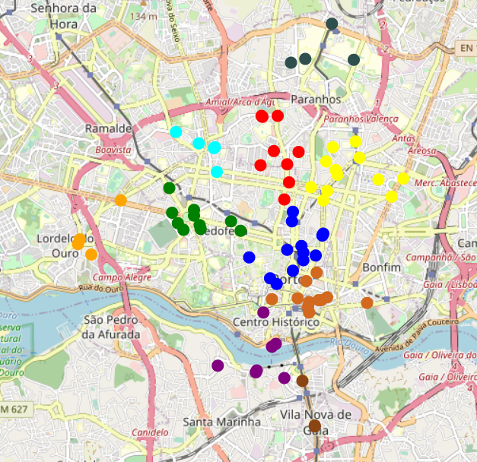
Clustering restaurans and bars
K-Means → 10 clusters
Figure 5 – Clustering restaurants and bars

Slide 9
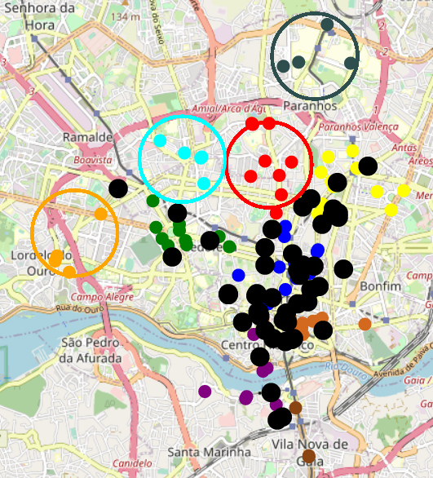
Identifying the opportunities
4 Regions;
Red and light blue regions
are highly recommended;
Orange and dark grey
regions are weakly recommended;

